Slide 1
Cocos Creator : Basic
Software Studio 軟體設計與實驗
Hung-Kuo Chu
Department of Computer Science
National Tsing Hua University
CS2410

Slide 2
Scene
Scenes contain the environments and menus of your game.
Think of each unique Scene file as a unique level. In each Scene, you place your environments, obstacles, and decorations, essentially designing and building your game in pieces.
In Cocos Creator, scene will be saved as .fire file.

Slide 3
Add Scene
Every project should start from a scene, so it’s important to know how to create a new scene.
Do File -> New Scene or Press right click in Assets and choose Create -> Scene, then Cocos Creator will generate an empty scene.

Slide 4
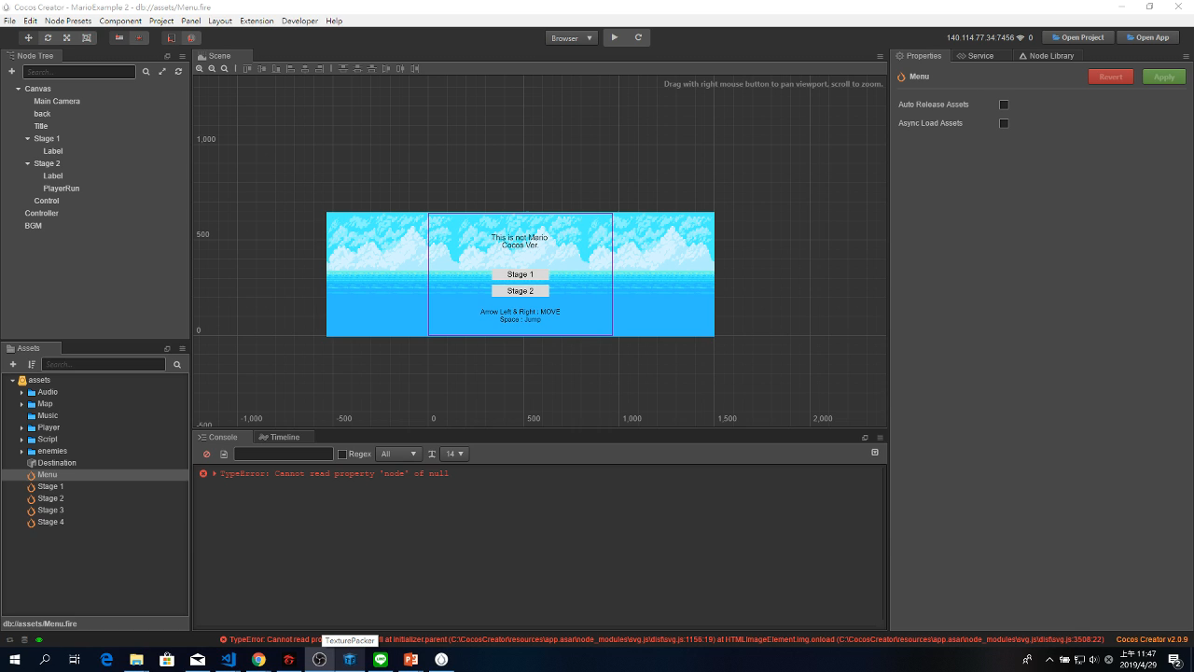
Add Scene
File -> New Scene

Slide 5
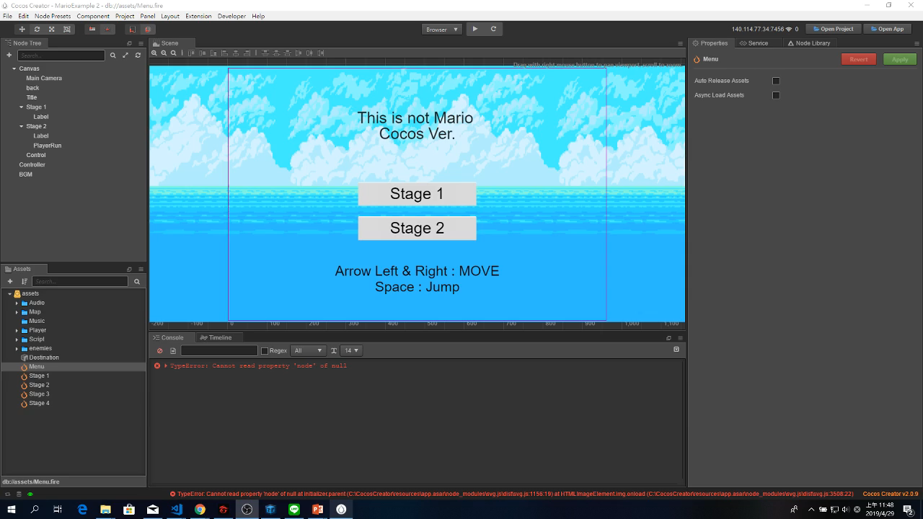
Add Scene
Press right click in Assets

Slide 6
Save Scene
When you want to go to edit other scenes, you can save the current one before leaving it.
Press Ctrl + S or File -> Save Scene to save the current scene into Assets.
If you are editing a non-stored scene, then you must name your scene when saving it.

Slide 7
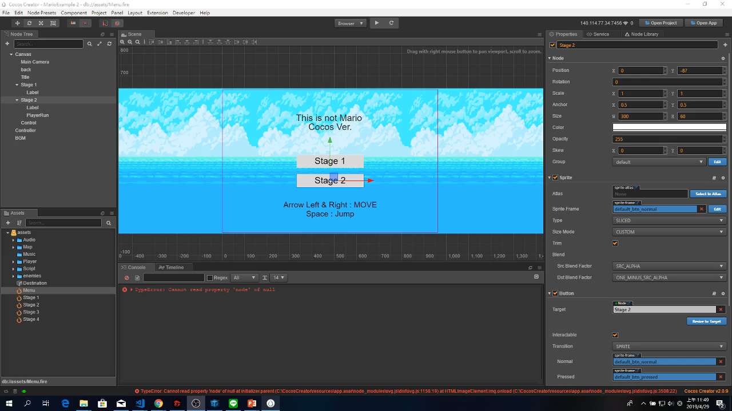
Save Scene
File -> Save Scene

Slide 8
Load Scene
If you want to edit another scene, you have to load it first.
Double click on the scene in Assets to load it.
You can see the title of Cocos Creator to check which scene you are editing now.

Slide 9
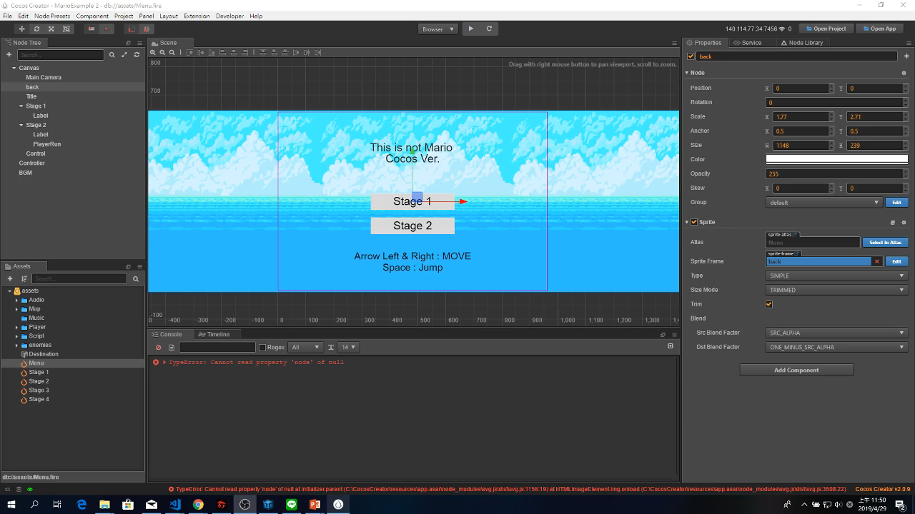
Load Scene
Double click on the scene in Assets

Slide 10
Node
In Cocos Creator, we can use node as item, like GameObject in Unity.
We edit and manage these nodes to make them do what we want them to do.
Background, Player, NPC, Text, UI…can be considered as kinds of node.

Slide 11
Add Node
After creating a scene, the first thing to do is to create a node and add it to the scene.
There are four ways to create a node:
Press right click on Node Tree
Press add button on the left top of Node Tree
Drag prefab from Assets
Drag from Node Library

Slide 12

Add Node
Press right click on Node Tree

Slide 13
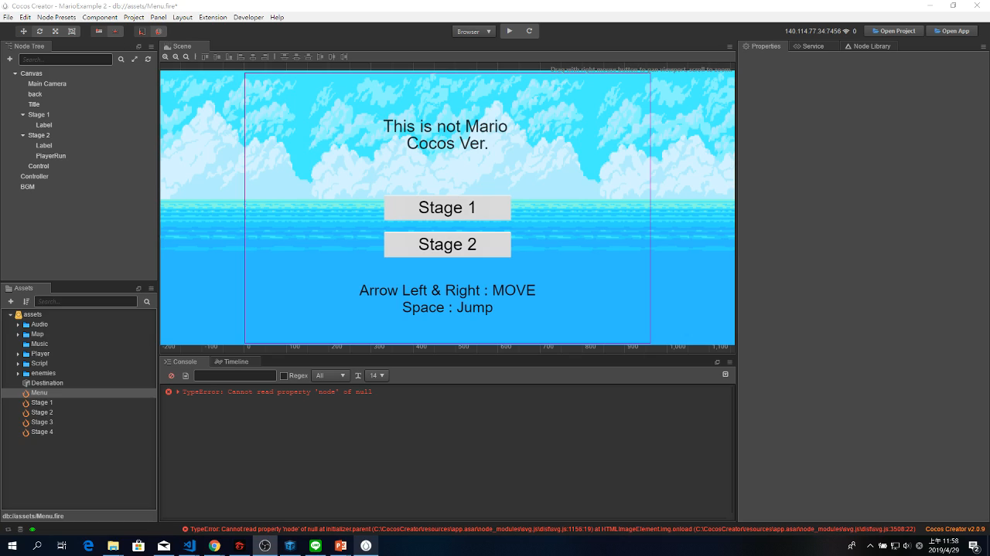
Add Node
Press add button on the left top of Node Tree

Slide 14

Add Node
Drag prefab from Assets

Slide 15

Add Node
Drag from Node Library

Slide 16
Rename Node
Good naming to node can help you understand the usage of this node and use it in script.
Select node, press right click choose Rename or press F2 or press Enter can rename the node.

Slide 17
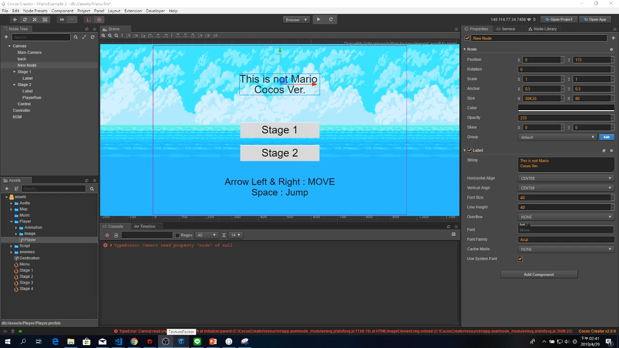
Rename Node

Slide 18
Edit Node’s Properties
Select the node you want to edit in the node tree, and then change properties in Properties panel.
The component’s properties can also be changed here.

Slide 19
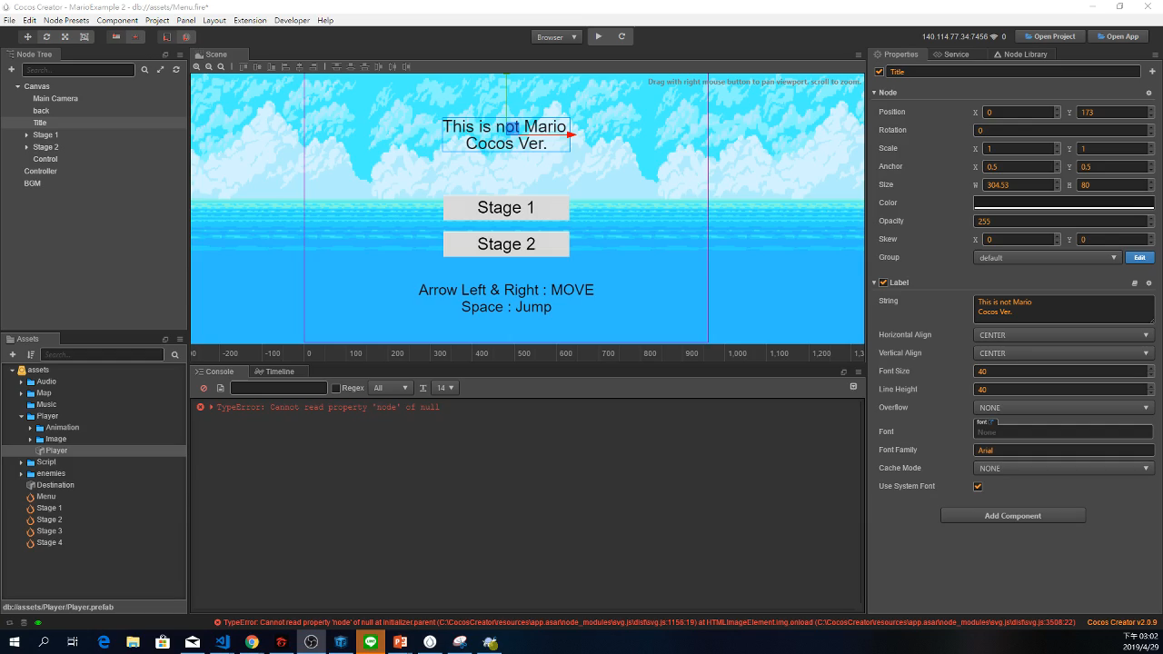
Edit Node’s Properties

Slide 20
Component ?
It gives a node additional features. In Cocos Creator, components have many types. For example, script, sprite, label, animation …
Some of them can co-exist at one node at the same time, but some can’t. Ex : Sprite and Label.

Slide 21
Component
Sprite
Label
Button
Script
Animation
Tile Map
Particle System
…

Slide 22
Node and components
In Cocos Creator, a node is defined by the components it has.
Example: A node that shows text on the screen is defined by having a “Label” component.
Similar to objects in JavaScript.
Game developers take advantage of components to reuse code between nodes!
Notes:
Other example: A rigid-body box is defined by having a “Rigidbody” component, a “PhysicsBoxCollider” component, and a “Sprite” component with the sprite of a box assigned to it.
This extends to custom components as well. A component that records “HP” (health) could be reused on both the player and enemies, for example.
(A big reason why this paradigm is used for pretty much every game engine)
Similar to prototype objects:
The relationship between a cc.Node and its components is very close to that between a JavaScript object and its properties. The only difference is that a node’s components have to be checked through getComponent and that the game engine needs to send events to every component.
This similarity naturally extends to the concept of node instantiation. “cc.instantiate” can be used to clone any node, like how “Object.create” can be used to clone any JavaScript object.

Slide 23
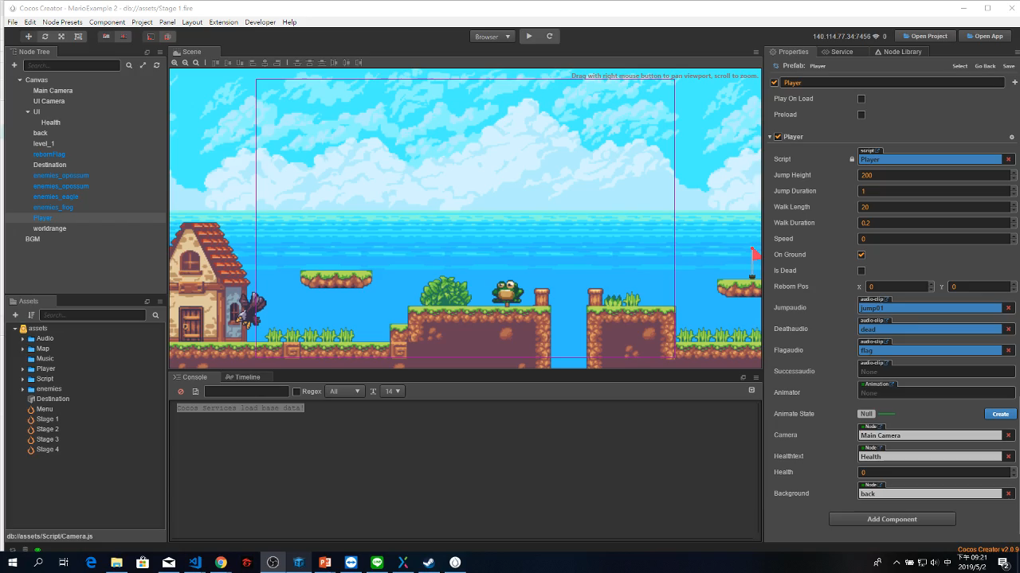
Add component
You can add component to node in Properties.

Slide 24
Edit component
Just like the way we edit node properties; we can change each component of node in Properties.

Slide 25

Prefab
Prefab means Prefabricated. Like the principle of “Shadow clone jutsu”, by turning a node into a prefab, we won’t have to build it from scratch in a different scene.

Slide 26
Create Prefab
You can choose the folder where you want to store the prefab. Cocos Creator can help us visualize the result.
Drag your node from Node Tree to Assets.

Slide 27
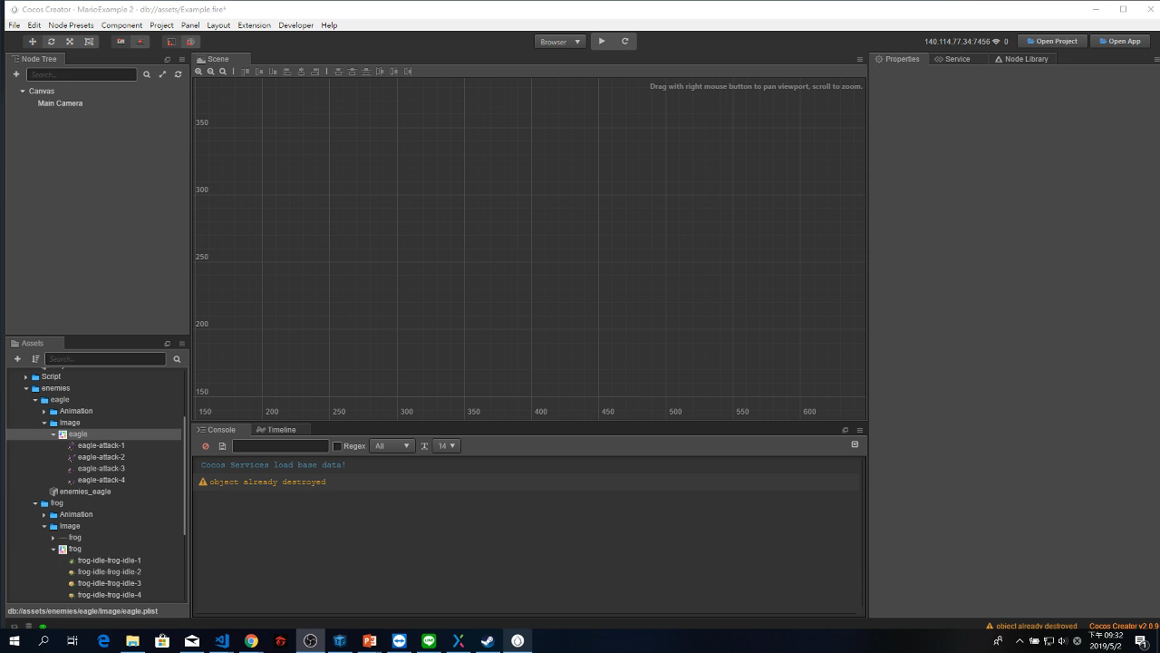
Create Prefab

Slide 28
Load Prefab
You can choose the position or hierarchy in Node Tree when you import prefab.
Drag your prefab from Assets to Node Tree or Scene.

Slide 29
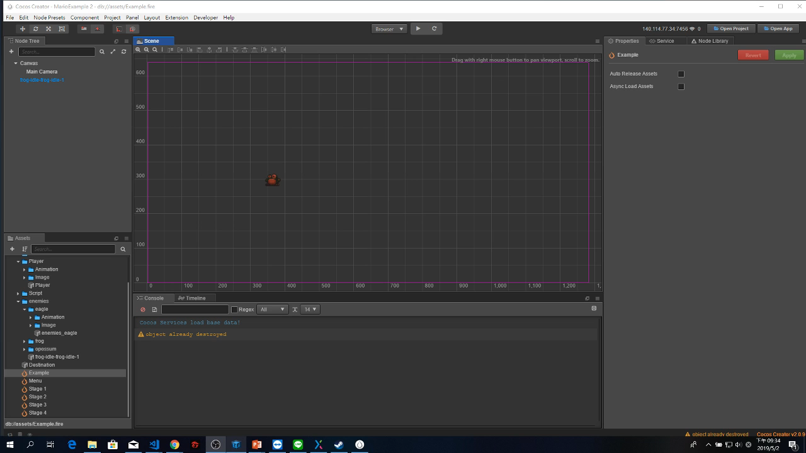
Load Prefab

Slide 30
Edit Prefab
The benefit of using prefabs is that not only can we create a clone node quickly but also keep the particularity of every clone prefab in each scene.
Besides, Cocos Creator provides a special view let us edit prefab in it.
Notice that you must reload prefab in scene if you edit your prefab.

Slide 31
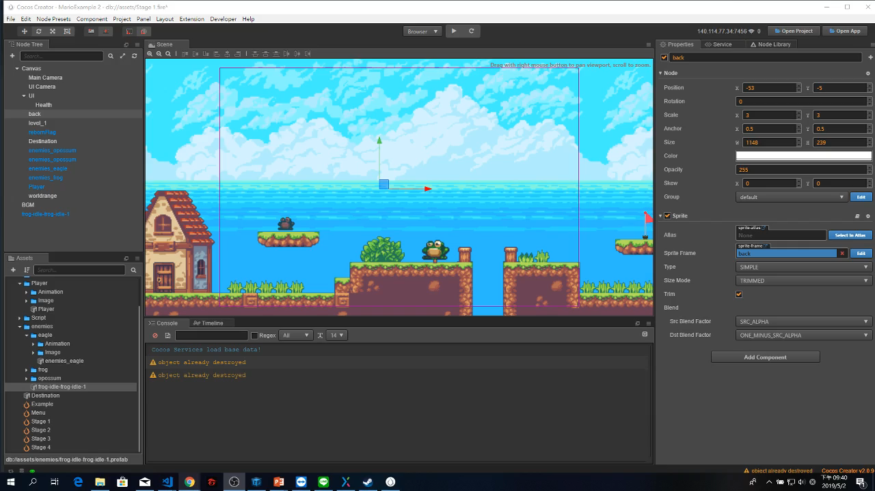
Edit Prefab

Slide 32





